Slide 1
STEP BY STEP GUIDE
FOR DEMAT ACCOUNT OPENING
(BULLION)
WITH IIDI DEPOSITORY
(India International Depository IFSC Ltd)

Slide 2
Do’s and Don’ts
DO NOT USE PENCIL TO FILL THE FORM.
USE OF WHITENER IS NOT PERMITTED.
CORRECTION ON ANY PAGE IS NOT PERMITTED.
PLEASE AVOID SPELLING MISTAKES ON THE FORM.
USE OF BLUE AND BLACK PEN IS ALLOWED.
PLEASE ENSURE WRITTEN DETAILS ARE CLEAR AND READABLE.
PLEASE ENSURE ALL THE MANDATORY FIELDS MARKED AS * ARE FILLED.
PLEASE ENSURE YOU DO SIGNATURE AS AVAILABLE ON PAN CARD.
ONLY VET SIGNATURES ARE CONSIDERED.

Slide 3
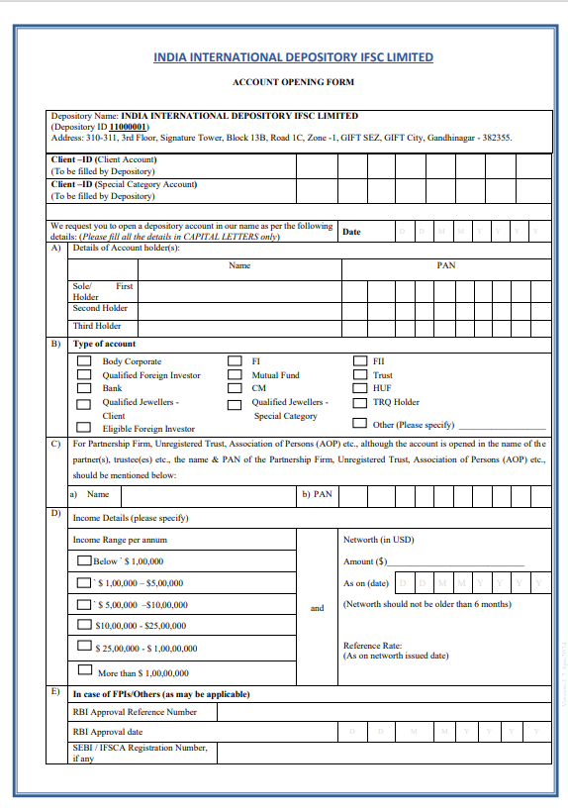
ACCOUNT OPENING FORM
MENTION DATE OF APPLICATION
NAME OF THE COMPANY
MENTION PAN NUMBER
OF THE COMPANY
TICK ON ANY OF THE BOX
AS APPLICABLE – 1. QUALIFIED SUFPPLIER
HAVE TO TICK ON ELIGIBLE FOREIGN INVESTOR
2. IF YOU WISH TO OPEN A/C UNDER TRQ TICK MARK TRQ HOLDER 3. IF YOU WISH TO OPEN A/C AS QUALIFIED JEWELLER TICK QUALIFIED JEWELLERS -CLIENT
FILL NAME OF THE COMPANY ONLY IN CASE OF PARTNERSHIP FIRM, UNREGISTERED TRUST, ASSOCIATION OF PERSONS (AOP) ALONG WITH PAN DETAILS
MENTION NETWORTH OF THE COMPANY EITHER IN USD OR INR
1. MENTION REFERENCE RATE AND DATE OF THE REFERENCE RATE TAKEN INTO CONSIDERATION
TICK MARK ON ANY OF THE FOLLOWING AS APPLICABLE
ALL PAGES OF ACCOUNT OPENING FORM SHOULD BE DULY SIGNED AND STAMPED BY AUTHORISED SIGNATORY

Slide 4
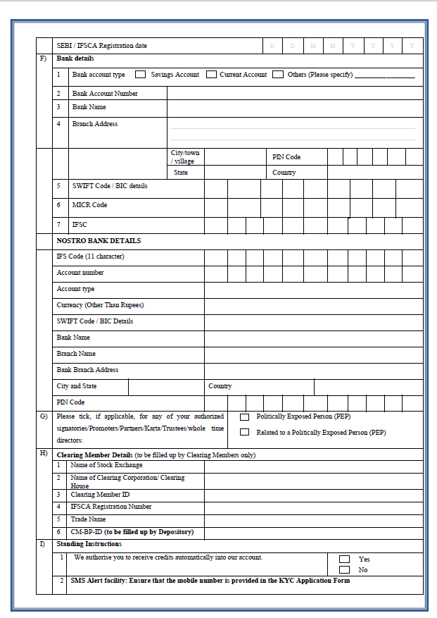
SELECT ANY OF THE OPTIONS
(AS APPLICABLE)
FILL BANK DETAILS AS AVAILABLE
IN BANK’S CANCELLED CHEQUE OR
BANK STATEMENT (PLEASE ENSURE YOU FILL
DETAILS OF THE BANK ACCOUNT WHICH IS ON
THE NAME OF ENTITY)
*ALL FIELDS ARE MANDATORY
MENTION DETAILS ONLY IN CASE OF QUALIFIED SUPPLIER
PLEASE TICK MARK ON YES

Slide 5


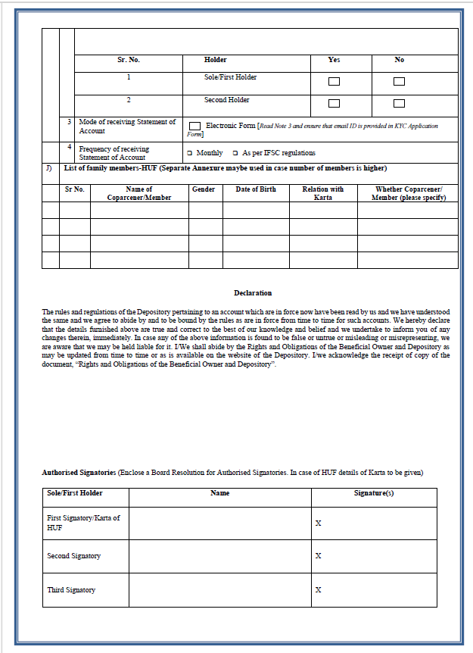



KINDLY MARK/TICK THE BOXES (AS PREFERRED)
– THIS WILL ENSURE YOU GET SMS ALERTS
PLACE A TICK MARK
NOTE -
FOR RECEIVING STATEMENT OF ACCOUNT IN ELECTRONIC FORM:
I. CLIENT MUST ENSURE THE CONFIDENTIALITY OF THE PASSWORD OF THE EMAIL ACCOUNT.
II. CLIENT MUST PROMPTLY INFORM THE DEPOSITORY IF THE EMAIL ADDRESS HAS CHANGED.
III. CLIENT MAY OPT TO TERMINATE THIS FACILITY BY GIVING 10 DAYS PRIOR NOTICE. SIMILARLY, DEPOSITORY MAY ALSO TERMINATE THIS FACILITY BY GIVING 10 DAYS PRIOR NOTICE.
PLACE A TICK MARK IN THE BOXES THAT YOU WANT TO SELECT.
PLEASE WRITE NAME/S OF AUTHORISED SIGNATORY/IES AS PER BOARD RESOLUTION
(KINDLY MENTION NAME AS WRITTEN ON PAN) –
SIGNATURE MUST MATCH WITH THE PAN CARD COPY

Slide 6
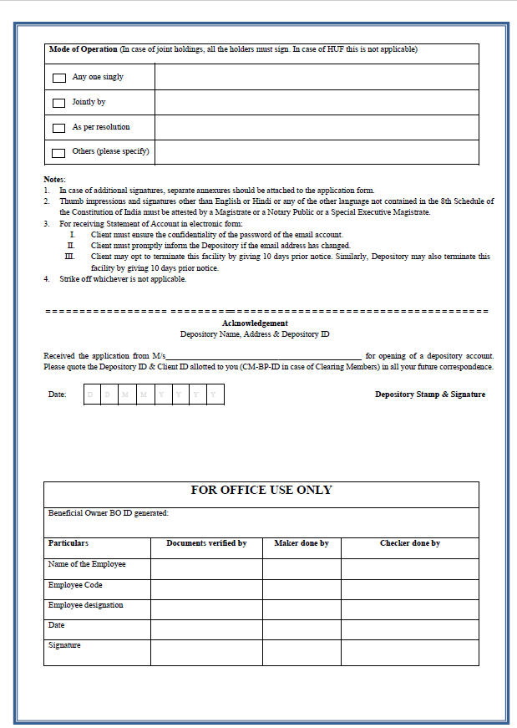
KINDLY MARK/TICK THE BOXES THAT APPLY
(IF YOU WANT THE ACCOUNT TO BE OPERATED SINGLY BY ANY OF THE SIGNATORY THEN MARK (ANY ONE SINGLY) OR YOU MAY MARK AS PER RESOLUTION (WHERE YOU NEED TO SELECT MODE OF OPERATIONS)

Slide 7
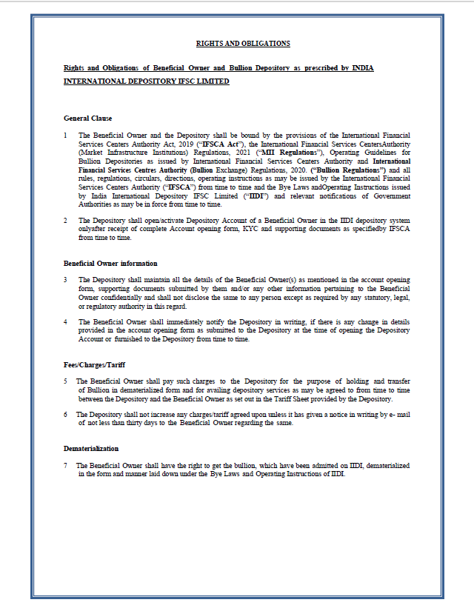
THE FORM NEEDS TO BE DULY
SIGNED AND STAMPED BY THE AUTHORISED SIGNATORY

Slide 8
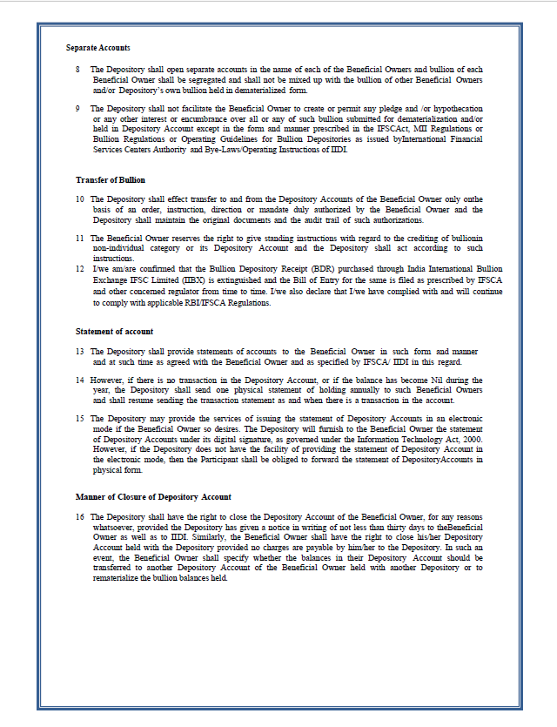
THE FORM NEEDS TO BE DULY
SIGNED AND STAMPED BY THE AUTHORISED SIGNATORY

Slide 9
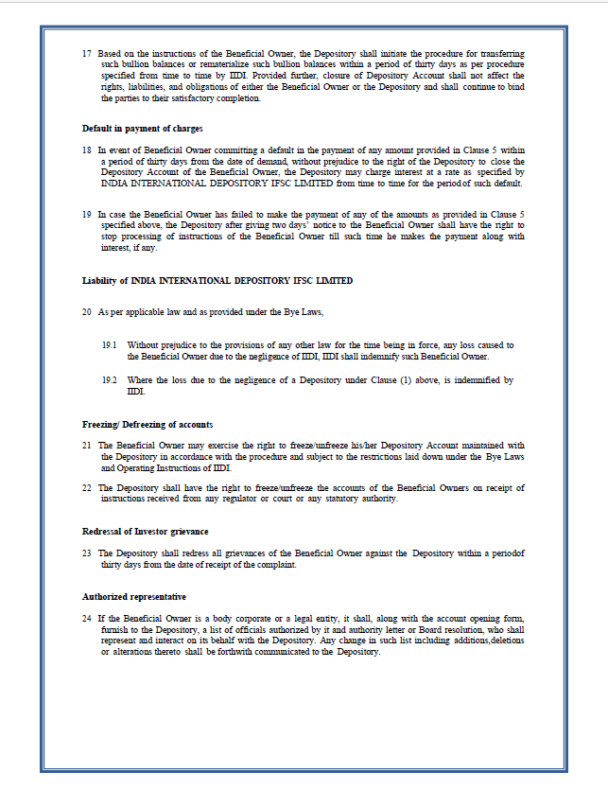
THE FORM NEEDS TO BE DULY
SIGNED AND STAMPED BY THE AUTHORISED SIGNATORY

Slide 10
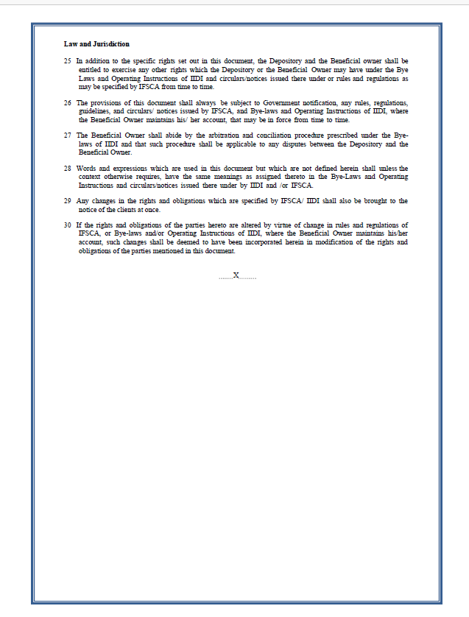
THE FORM NEEDS TO BE DULY
SIGNED AND STAMPED BY THE AUTHORISED SIGNATORY

Slide 11
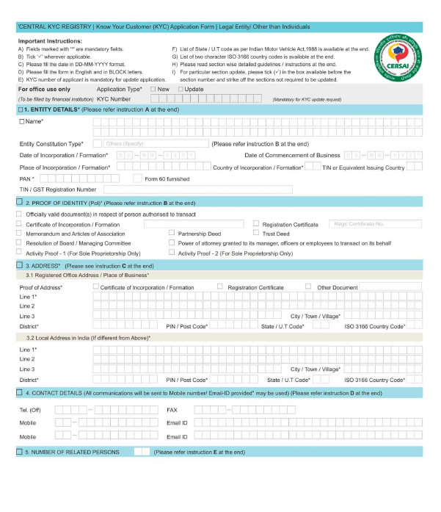
FIRST PAGE OF CKYC (ENTITY)
NOTE – PLEASE CHECK STEP BY STEP GUIDE FOLLOWED BY THIS PAGE TO FILL THE CKYC ENTITY FORM
PLEASE AVOID CORRECTIONS ON ANY PAGE OF THE ACCOUNT OPENING FORM
USE OF WHITENER (CORRECTION FLUID) IS NOT PERMITTED

Slide 12
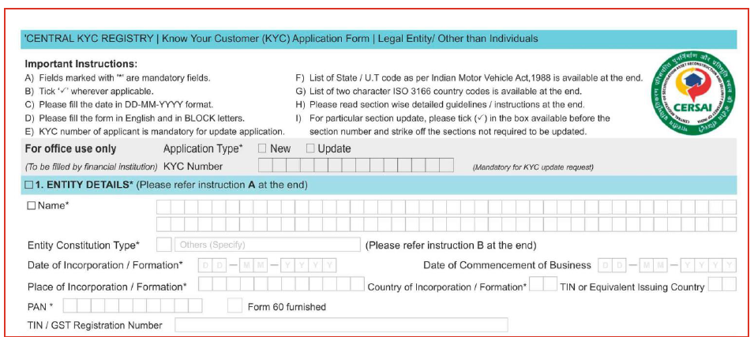
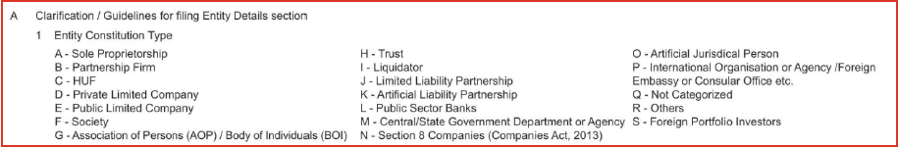
1. ENTITY DETAILS
PLACE A TICK MARK IN THE BOX
(“UPDATE OPTION TO BE MARKED ONLY IN CASE OF RE-KYC)
WRITE NAME OF THE ENTITY
AS WRITTEN ON THE PAN
OR CERTIFICATE OF INCORPORATION
WRITE DATE OF INCORPORATION AND COMMENCEMENT OF BUSINESS
(YOU WILL GET THE DETAILS FROM CERTIFICATE OF INCORPORATION/ UDHYAM CERTIFICATE)
MENTION COUNTRY OF INCORPORATION
FOR INDIA – “IN” & FOR UAE – “AE”
MENTION PLACE OF INCORPORATION - YOU WILL GET THE INFORMATION FROM CERTIFICATE OF INCORPORATION/ SHOP & ESTABLISHMENT OR GST CERTIFICATE
PAN CARD NUMBER OF ENTITY
TO BE WRITTEN IN THE FIELD (IN CASE
OF PROPRIETORSHIP MENTION PAN NUMBER OF PROPRIETOR)

Slide 13
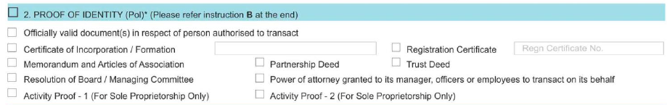
2. PROOF OF IDENTITY
MENTION CERTIFICATE OF INCORPORATION NUMBER AGINST THE GIVEN FIELD AND REGISTRATION NUMBER ONLY IF YOU SELECT THE BOXES
PLACE A TICK MARK (SELECT THOSE PROOFS
WHICH YOU ARE SHARING ALONGWITH THE ACCOUNT OPENING FORM)
FOR PRIVATE LIMITED COMPANIES – CERTIFICATE OF INCORPORATION,
MEMORANDUM OF ASSOCIATION & RESOLUTION OF BOARD CAN BE MARKED.
2. FOR PARTNERSHIP FIRMS PARTNERSHIP DEED.
3. FOR PROPRIETORSHIP FIRM YOU MAY SELECT ACTIVITY PROOF 1 OR 2 (AS APPLICABLE)

Slide 14
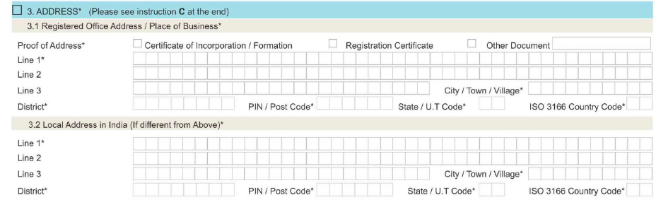
3. ADDRESS
PLACE A TICK MARK ON OTHER DOCUMENT AND MENTION “BANK STATEMENT” OR “UTILITY BILL” AS APPLICABLE
MENTION ADDRESS AS WRITTEN ON BANK STATEMENT OR UTILITY BILL (PLEASE AVOID SPELLING MISTAKES)
MENTION CITY NAME, DISTRICT, PIN CODE AND STATE CODE,
COUNTRY CODE FOR INDIA – “IN”
FOR UNITED ARAB EMIRATES – “AE” (ONLY FOR QUALIFIED SUPPLIER CLIENT) - DETAILS SHOULD MATCH FROM THE BANK STATEMENT OR UTILITY BILL
WRITE SAME AS ABOVE IF THE REGISTERED ADDRESS IS SAME AS LOCAL ADDRESS
(PROVIDE ADDRESS PROOF IF IT VARIES)
NOTE – CERTIFICATE OF INCORPORATION AND REGISTRATION CERTIFICATE IS NOT CONSIDERED AS ADDRESS PROOFS.

Slide 15
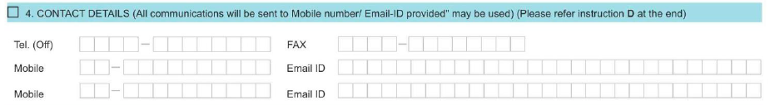
4. CONTACT DETAILS
STD CODE TO BE WRITTEN
IN THE FIELD GIVEN (PLEASE MENTION TWO DIGIT COUNTRY CODE)
EX – FOR INDIAN MOBILE NUMBER 91-9999999999
PLEASE MENTION EMAIL ID AND MOBILE NUMBER

Slide 16
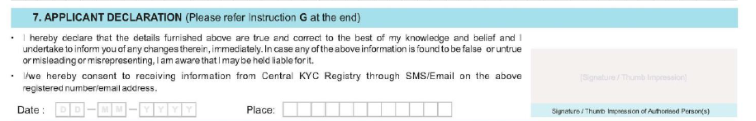
7. APPLICANT DECLARATION
SIGNATURE OF AUTHORISED PERSON REQUIRED
MENTION DATE AND PLACE IN THE GIVEN FIELDS
COMPANY STAMP REQUIRED ON THE PAGE

Slide 17
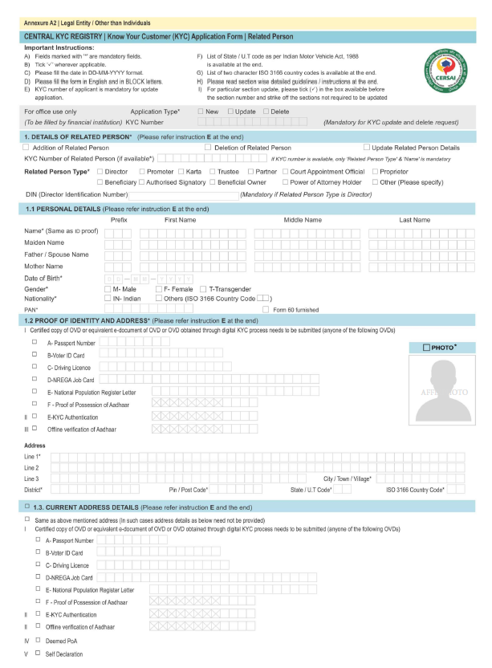
CKYC INDIVIDUAL FORM
NOTE – PLEASE CHECK STEP TO STEP GUIDE FOLLOWED BY THIS PAGE TO FILL THE CKYC INDIVIDUAL FORM ;-
PLEASE AVOID CORRECTIONS ON ANY PAGE OF THE ACCOUNT OPENING FORM
USE OF WHITENER (CORRECTION FLUID) IS NOT PERMITTED

Slide 18
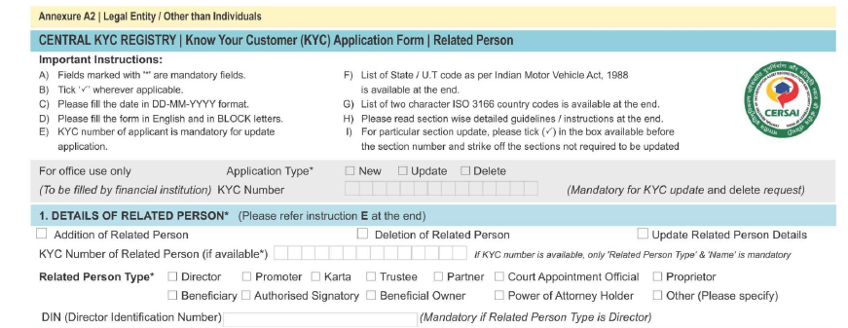
1. DETAILS OF RELATED PERSON
PLACE A TICK MARK IN THE BOX
(“UPDATE OPTION TO BE MARKED ONLY IN CASE OF RE-KYC)
SELECT PERSON TYPE
(IN CASE OF COMPANY DIRECTOR – TICK MARK ON “DIRECTOR” , IN CASE OF PARTNERSHIP FIRM PLACE A TICK MARK ON “PARTNER”, IN CASE OF PROPRIETOSHIP – TICK MARK ON “PROPRIETOR”, IN CASE OF AUTHORISED SIGNATORY – TICK MARK ON “AUTHORISED SIGNATORY”
MENTION DIN NUMBER OF DIRECTORS
(ONLY APPLICABLE IN PRIVATE LIMITED
COMPANIES)

Slide 19
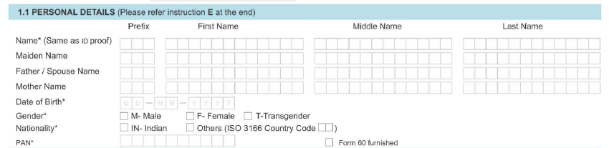
1.1 PERSONAL DETAILS
MENTION NAME AS WRITTEN
ON THE PAN CARD
KINDLY MENTION THE PREFIX
KINDLY MENTION THE PREFIX
WRITE FATHER’S NAME
AS WRITTEN ON THE PAN CARD
PLACE A TICK MARK (AS APPLICABLE)
DATE OF BIRTH TO BE MENTIONED
AS AVAILABLE ON PAN CARD
MENTION PAN NUMBER OF THE APPLICANT
NOTE – PLEASE ENSURE ALL THE DETAILS FILLED ARE AS PER PAN
1. PLEASE AVOID SPELLING MISTAKE AND ENSURE APPLICANT NAME AND FATHER NAME IS WRITTEN AS AVAILABLE ON PAN.
2. PAN NUMBER MUST BE WRITTEN CLEARLY

Slide 20
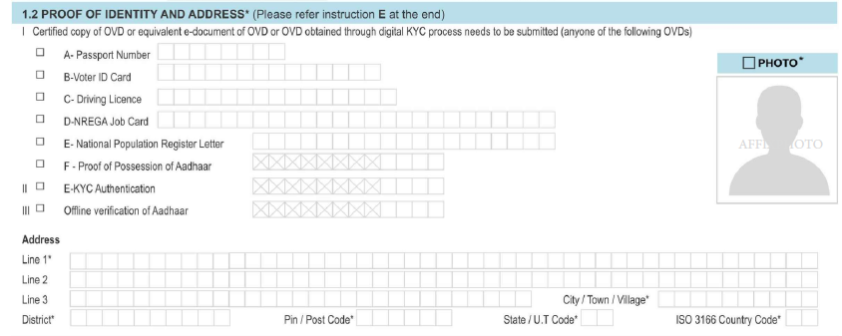
1.2 PROOF OF IDENTITY AND ADDRESS
PLACE A TICK MARK (MENTION PASSPORT NUMBER ONLY APPLICABLE TO (NON – RESIDENT INDIANS)
AFFIX LATEST PHOTOGRAPH OF THE APPLICANT
PLACE A TICK MARK
&
MENTION LAST 4 DIGITS OF AADHAR NUMBER (FOR INDIAN RESIDENTS)
MENTION CITY NAME, DISTRICT, PIN CODE AND STATE CODE,
COUNTRY CODE FOR INDIA – “IN” , FOR UNITED ARAB EMIRATES – “AE” (ONLY FOR QUALIFIED SUPPLIER CLIENT)
ADDRESS MUST MATCH FROM AADHAR (INDIAN RESIDENTS)
2. ADDRESS MUST MATCH FROM PASSPORT (NON-RESIDENT INDIAN)

Slide 21
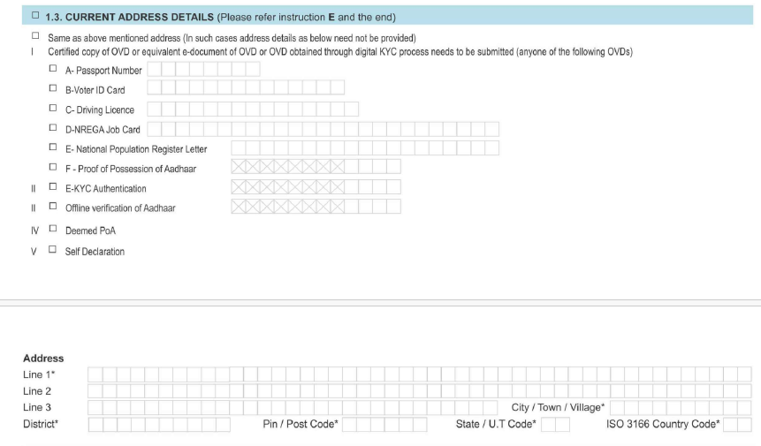
1.3 CURRENT ADDRESS DETAILS
PLACE A TICK MARK ON THIS ONLY IF THE ADDRESS IS SAME AS MENTIONED IN 1.2
MENTION ADDRESS AS AVAILABLE ON PASSPORT ONLY FOR (NON- RESIDENT INDIANS) – QUALIFIED SUPPLIER

Slide 22
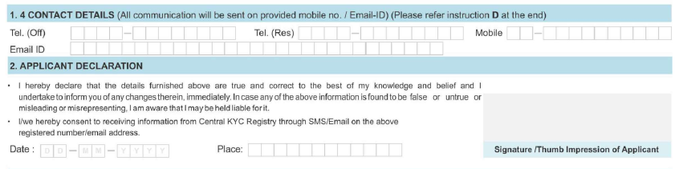
1.4 CONTACT DETAILS
STD CODE TO BE WRITTEN
IN THE FIELD GIVEN (PLEASE MENTION TWO DIGIT COUNTRY CODE) EX – FOR INDIAN MOBILE NUMBER 91-9999999999
MENTION MOBILE NUMBER AND EMAIL ID
SIGNATURE OF APPLICANT
PLEASE MENTION DATE AND PLACE

Slide 23
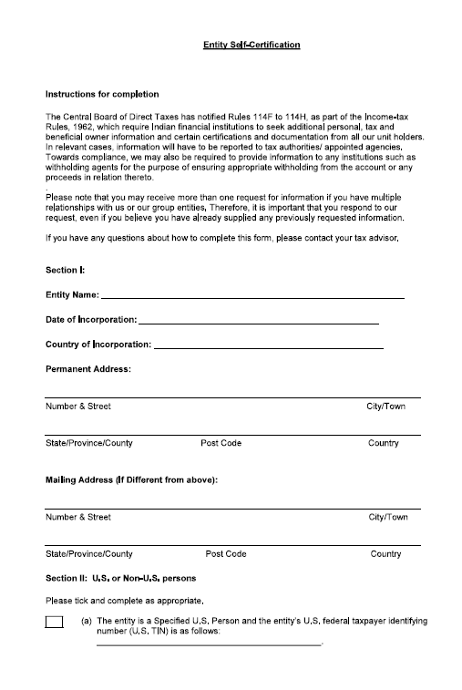
ENTITY SELF CERTIFICATION (FATCA)
ENTITY NAME TO BE WRITTEN AS PER PAN CARD
OR AS PER CERTIFICATE OF INCORPORATION
TO BE WRITTEN AS PER PAN CARD OR
AS PER CERTIFICATE OF INCORPORATION
MENTION COUNTRY OF INCORPORATION
MENTION COMPANY ADDRESS AS WRITTEN ON
“BANK STATEMENT” OR “UTILITY BILL”
MENTION “NA” IF NOT APPLICABLE
SHOULD BE DULY SIGNED AND
STAMPED BY AUTHORISED SIGNATORY
PAGE 1

Slide 24
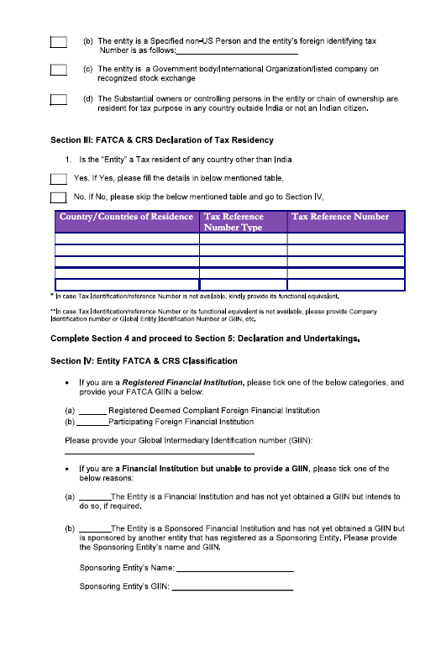
MENTION “NA” IF NOT APPLICABLE IN EACH FIELD
PLACE A TICK MARK IF NOT APPLICABLE
FILL IN DETAILS IF APPLICABLE IN POINT 1.
MENTION “NA” IF NOT APPLICABLE IN EACH FIELD
SHOULD BE DULY SIGNED AND
STAMPED BY AUTHORISED SIGNATORY
PAGE 2

Slide 25
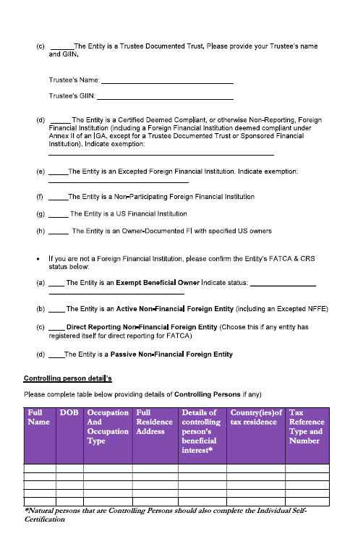
PAGE 3
MENTION “NA” IF NOT APPLICABLE IN EACH FIELD
MENTION “NA” IF NOT APPLICABLE IN EACH FIELD
FILL IN THE DETAILS AS PER BELOW INFORMATION ;-
FOR PRIVATE LIMITED COMPANY (MENTION DETAILS
OF ALL THE DIRECTORS HOLDING MORE THAN 10% STAKE)
2. FOR PARTNERSHIP FIRM (DETAILS OF PARTNERS HOLDING
MORE THAN 15% MUST BE MENTIONED)
3. FOR PROPRIETORSHIP FIRM – MENTION DETAILS OF PROPRIETOR ONLY
FILL IN DETAILS OF PROPRIETOR, PARTNERS OR DIRECTORS (ALL DETAILS SHOULD BE WRITTEN AS PER PAN CARD – NAME & D.O.B)
ADDRESS MUST BE AS WRITTEN IN AADHAR CARD (FOR QUALIFIED SUPPLIERS THE ADDRESS MUST BE WRITTEN AS PER “UTILITY BILL” OR “PASSPORT”)
MENTION PAN NUMBER IN THE GIVEN FIELD
% OF SHAREHOLDING TO BE MENTIONED IN THE GIVEN FIELD
SHOULD BE DULY SIGNED AND
STAMPED BY AUTHORISED SIGNATORY

Slide 26
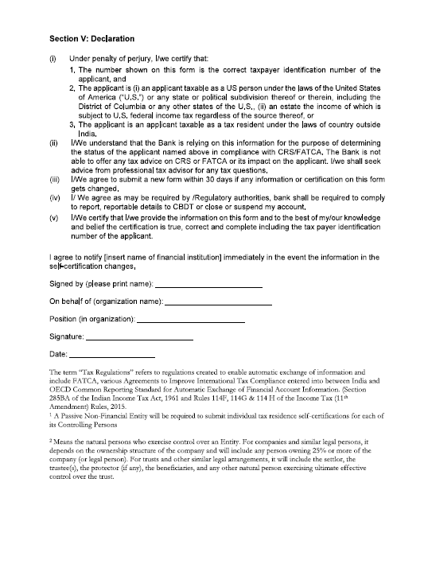
PAGE 4
MENTION ENTITY NAME AS WRITTEN ON
“PAN CARD” OR “CERTIFICATE OF INCORPORATION”
MENTION NAME OF AUTHORISD SIGNATORY
DESIGNATION TO BE MENTIONED
MENTION DATE & AUTHORISED SIGNATORY SIGNATURE REQUIRED (SIGNATURE MUST MATCH WITH THE SIGNATURE ON PAN)
SHOULD BE DULY SIGNED & STAMPED BY AUTHORISED SIGNATORY

Slide 27
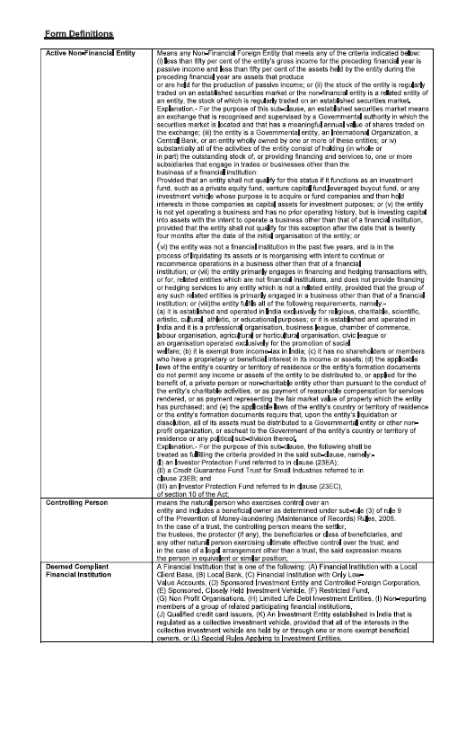
PAGE 5
SHOULD BE DULY SIGNED & STAMPED
BY AUTHORISED SIGNATORY

Slide 28
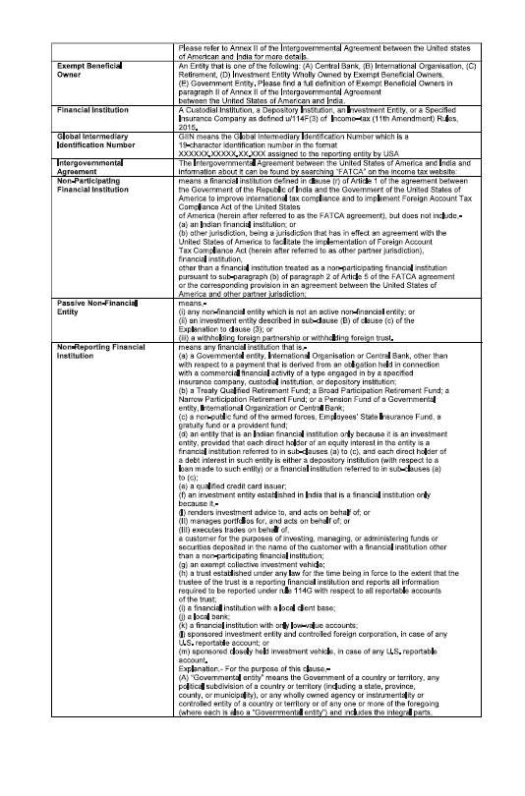
PAGE 6
SHOULD BE DULY SIGNED & STAMPED
BY AUTHORISED SIGNATORY

Slide 29
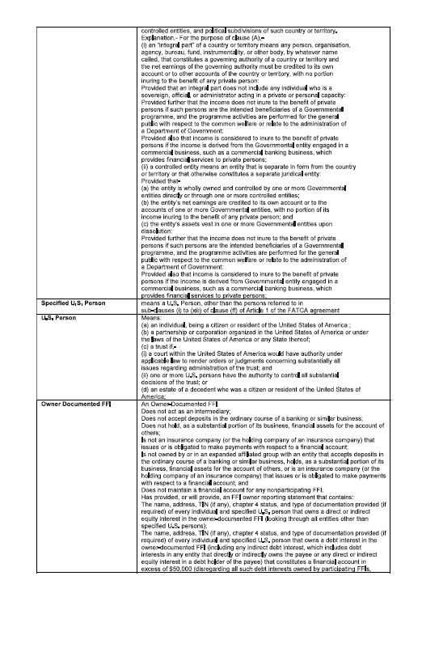
PAGE 7
SHOULD BE DULY SIGNED & STAMPED
BY AUTHORISED SIGNATORY

Slide 30
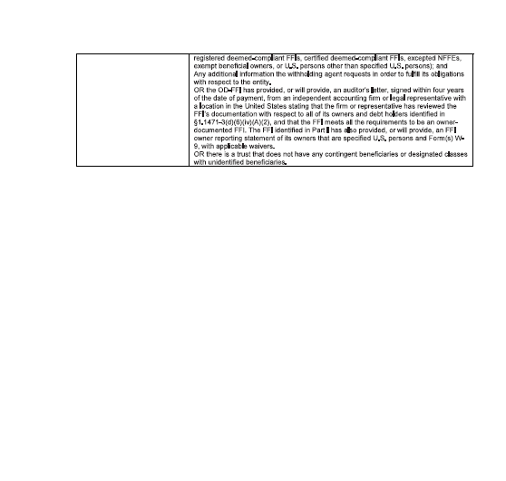
PAGE 8
SHOULD BE DULY SIGNED & STAMPED
BY AUTHORISED SIGNATORY

Slide 31
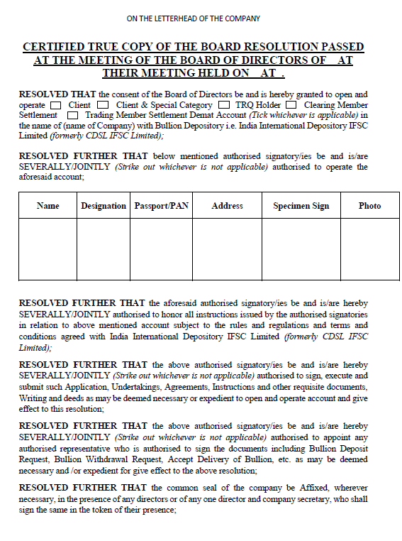
BOARD RESOLUTION
(MUST BE PREPARED ON THE LETTERHEAD OF THE COMPANY)
MENTION COMPANY FULL ADDRESS ALONGWITH PINCODE AS PER PROOF SHARED, DATE, PLACE AND TIME TO BE MENTIONED TOO
PLACE A TICK MARK ON THE APPROPRIATE BOX
FULL COMPANY NAME TO BE WRITTEN
1. WRITE NAME AS WRITTEN ON PAN CARD,
2. DESIGNATION TO BE MENTIONED,
3. MENTION PAN CARD NUMBER (FOR QUALIFIED SUPPLIERS MENTION PASSPORT NUMBER)
4. ADDRESS MUST BE WRITTEN AS AVAILABLE ON AADHAR
5. SIGNATURE TO BE DONE IN THE FIELD GIVEN
6. AFFIX LATEST PHOTOGRAPH
SELECT MODE OF OPERATIONS
(WHETHER SEVERALLY OR JOINTLY)
SELECT MODE OF OPERATIONS
(WHETHER SEVERALLY OR JOINTLY)
STRIKE OUT WHICHEVER IS NOT APPLICABLE
SHOULD BE DULY SIGNED & STAMPED
BY AUTHORISED SIGNATORY/IES
PAGE 1

Slide 32
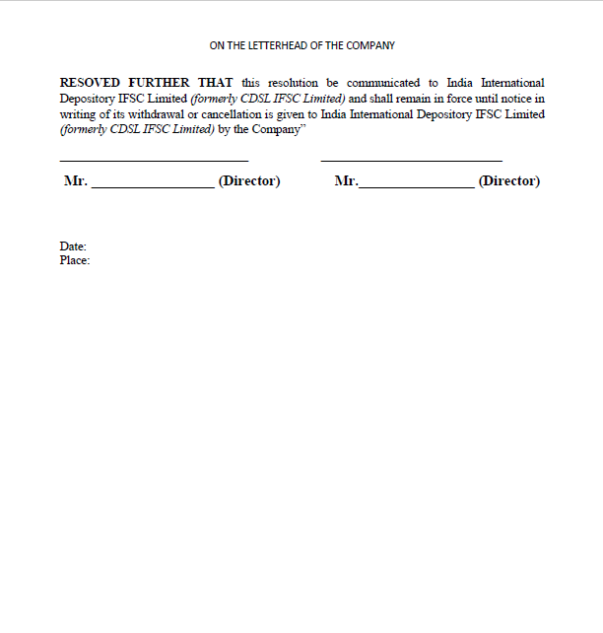
PAGE 2
NAME AND SIGNATURE ALONGWITH
COMPANY STAMP REQUIRED
NAME AND SIGNATURE ALONGWITH
COMPANY STAMP REQUIRED
MENTION DATE AND PLACE
SHOULD BE DULY SIGNED & STAMPED
BY AUTHORISED SIGNATORY/IES

Slide 33
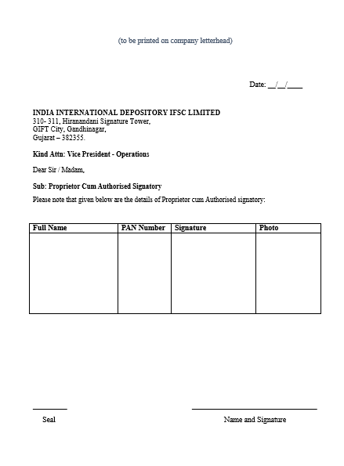
PROPRIETOR CUM AUTHORISED SIGNATORY
(TO BE PRINTED ON COMPANY LETTERHEAD)
PLEASE MENTION DATE
MENTION FULL NAME AS WRITTEN ON PAN, MENTION PAN NUMBER AND SIGNATURE MUST MATCH WITH PAN CARD
AFFIX LATEST PHOTOGRAPH
NAME AND SIGNATURE OF PROPRIETOR
PROPRIETOR’S SEAL REQUIRED

Slide 34
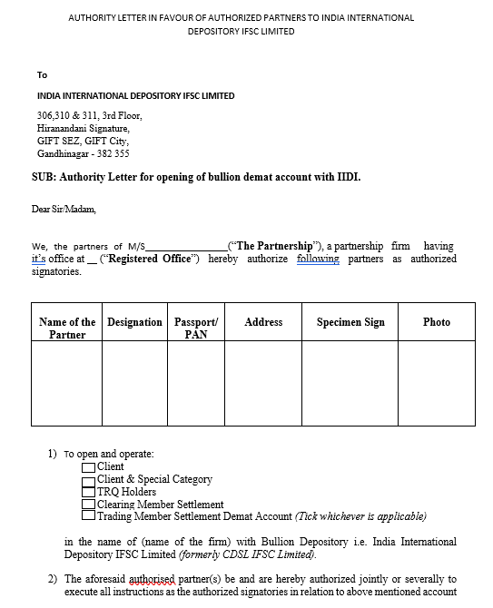
PARTNERSHIP RESOLUTION
(TO BE PREPARED ON COMPANY LETTERHEAD
MENTION NAME OF THE ENTITY
MENTION FULL ADDRESS OF THE ENTITY
AS PER “BANK STATEMENT” OR “UTILITY BILL”
AFFIX LATEST PHOTOGRAPH
DETAILS OF ALL THE AUTHORISED PARTNERS TO BE MENTIONED, MENTION DESIGNATION AND PAN OR PASSPORT NUMBER (ONLY IN CASE OF QUALIFIED SUPPLIERS)
NAME – MUST BE AS WRITTEN ON PAN CARD
ADDRESS – MUST BE AS WRITTEN ON AADHAR CARD
SIGNATURE – MUST BE AS PER PAN
PLACE A TICK MARK
FOR QUALIFIED JEWELLER & QUALIFIED SUPPLIER “CLIENT” SHOULD BE MARKED
FOR TRQ HOLDER “TRQ HOLDERS” TO BE MARKED
SELECT MODE OF OPERATION
WHETHER SEVERALLY OR JOINTLY
(STRIKE OUT WHICHEVER IS NOT APPLICABLE)
NAME OF THE FIRM TO BE MENTIONED
SHOULD BE DULY SIGNED & STAMPED
BY AUTHORISED PARTNER

Slide 35
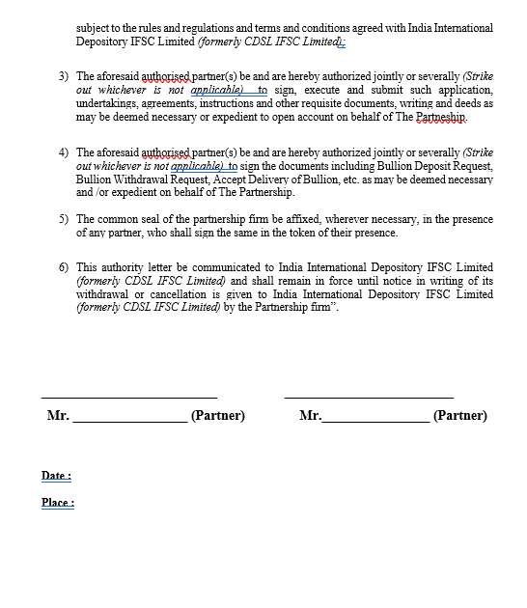
SELECT MODE OF OPERATIONS
WHETHER SEVERALLY OR JOINTLY
(STRIKE OUT WHICHEVER IS NOT APPLICABLE)
NAME OF PARTNERS TO BE WRITTEN
AND SIGNATURE TO BE DONE
PLEASE ENSURE SIGNATURE MATCHES
WITH THE PAN CARD
MENTION DATE AND PLACE
SHOULD BE DULY SIGNED & STAMPED
BY THE AUTHORISED SIGNATORY

Slide 36
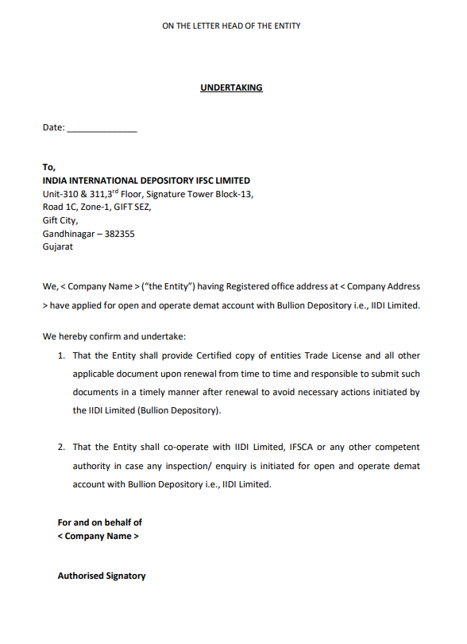
UNDERTAKING
(TO BE PREPARED ON COMPANY LETTERHEAD)
MENTION DATE
MENTION ENTITY NAME AS WRITTEN ON PAN
OR CERTIFICATE OF INCORPORATION
MENTION COMPANY ADDRESS
AS WRITTEN ON “BANK STATEMENT” OR “UTILITY BILL”
MENTION ENTITY NAME AS WRITTEN ON PAN
OR CERTIFICATE OF INCORPORATION
SHOULD BE DULY SIGNED & STAMPED
BY AUTHORISED SIGNATORY (MENTION FULL
NAME OF THE SIGNATORY)

Slide 37
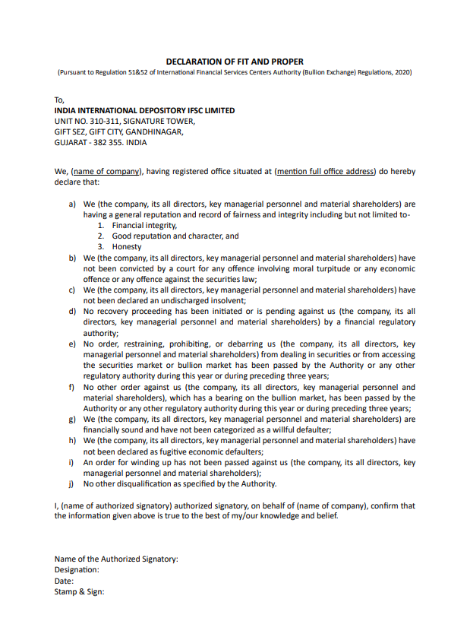
DECLARATION OF FIT & PROPER
(TO BE PREPARED ON COMPANY LETTERHEAD)
MENTION ENTITY NAME AS WRITTEN ON PAN
OR CERTIFICATE OF INCORPORATION
NAME OF AUTHORISED SIGNATORY
TO BE WRITTEN
MENTION ENTITY NAME AS WRITTEN ON PAN
OR CERTIFICATE OF INCORPORATION
1. MENTION NAME OF AUTHORISED SIGNATORY
2. DESIGNATION
3. DATE
4. STAMP AND SIGN TO BE DONE

Slide 38
THANK YOU FOR CHOOSING IIDI !!
(India International Depository IFSC Ltd)

